Slide 1





Storming the castl
A MCMC Tool for
Spectral Parameter Fitting
Hunter Brooks, Adam Burgasser, Efrain Alvarado, Jasmine Garani, Yves Wood, etc.

Slide 2


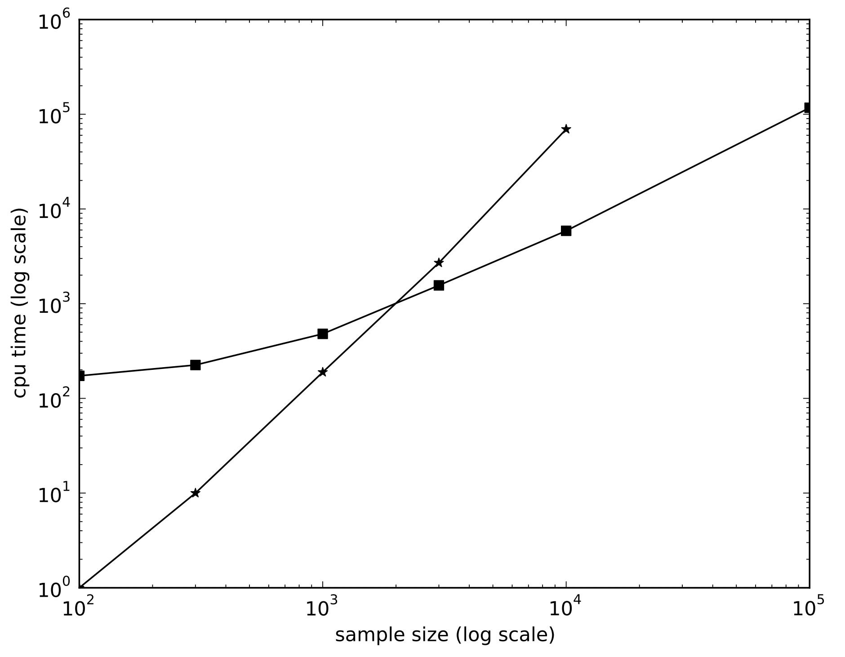
Why Should YOU Care?
2
1
# of Spectral Points
# of Parameters
HUGE
Sample Size
Costly CPU Time
http://svo2.cab.inta-csic.es/theory/newov2/

Slide 3
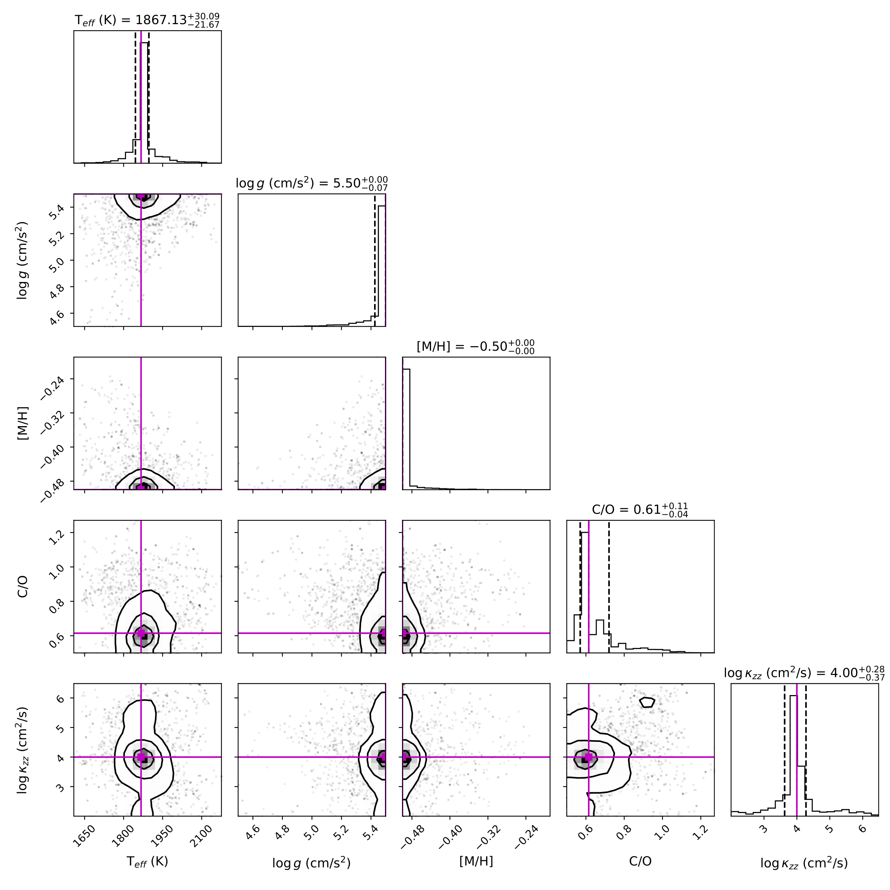
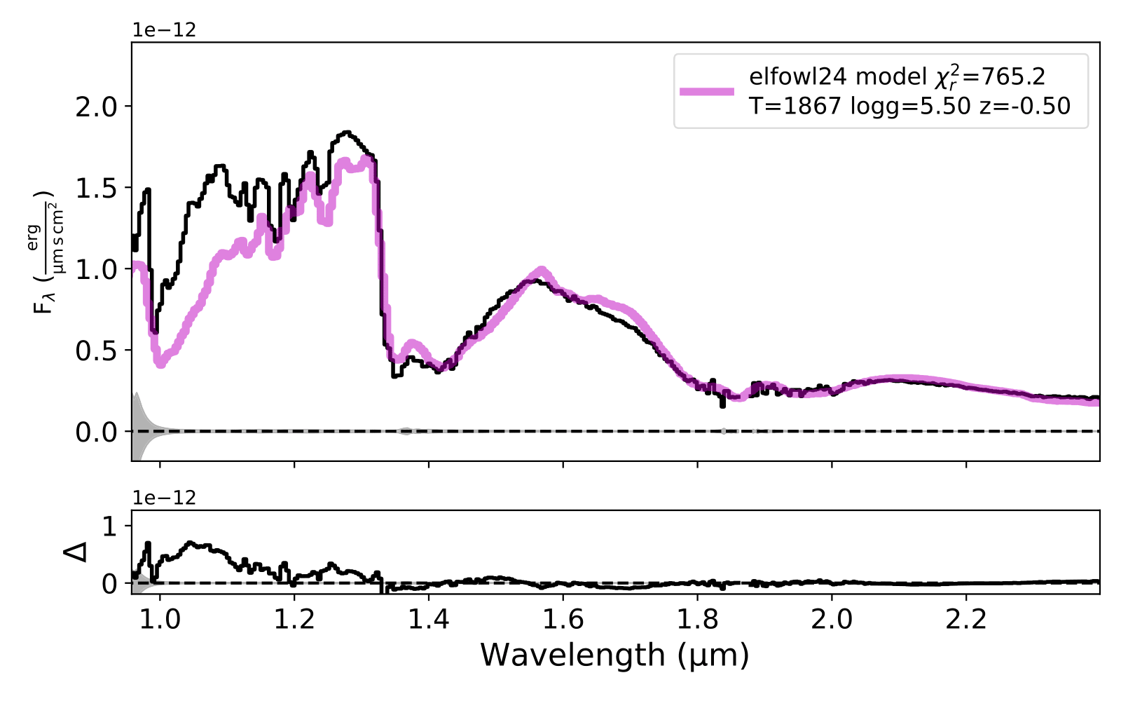
Previous Example
3
UCDMCMC
2,000 Steps
12:30min
MCMC with Interpolated Grid Each Step
2
3

Slide 4
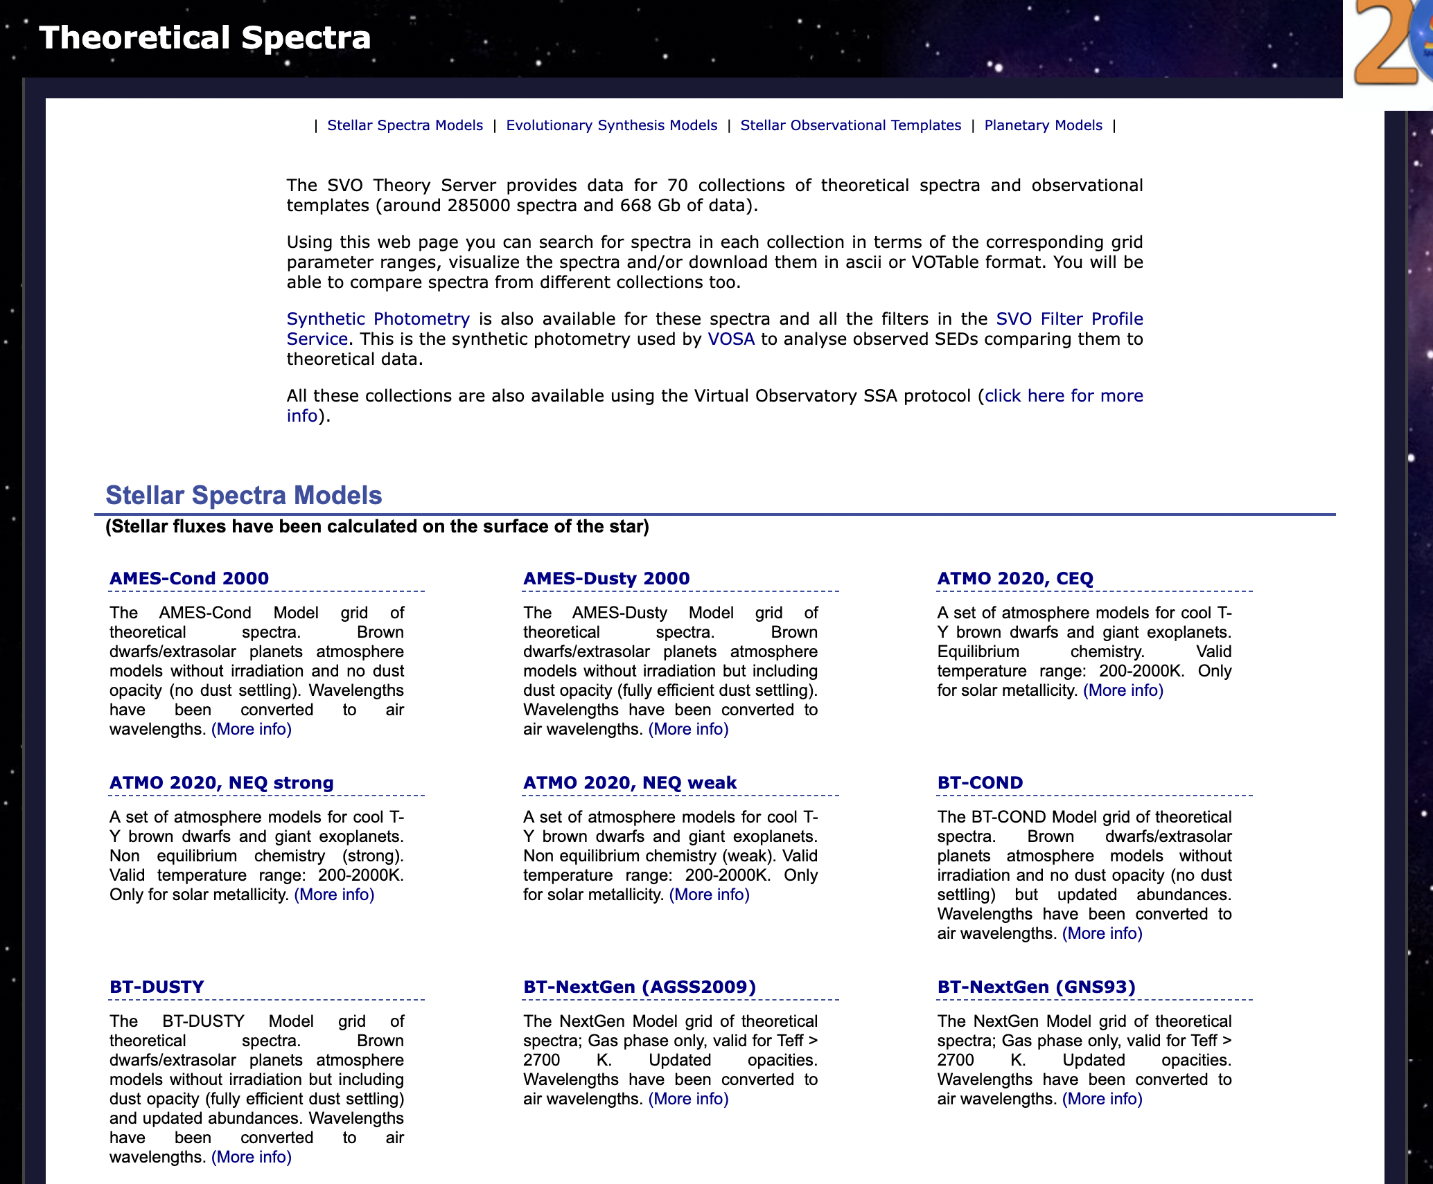
Structure of castl
4
Interpolation
MCMC
Model Grid
4
Interpolation Grid
Initial Position
Wavelength
interp1d Model
Sampler
Wavelength
interp1d Model
Parameter
Space Explored
Normalize Grid
Best Fit
Parameters
Building
Interpolation Grid
http://svo2.cab.inta-csic.es/theory/newov2/

Slide 5
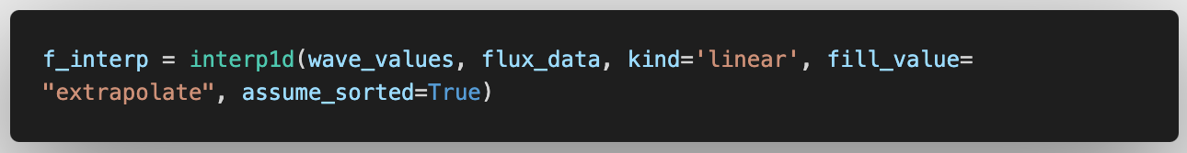
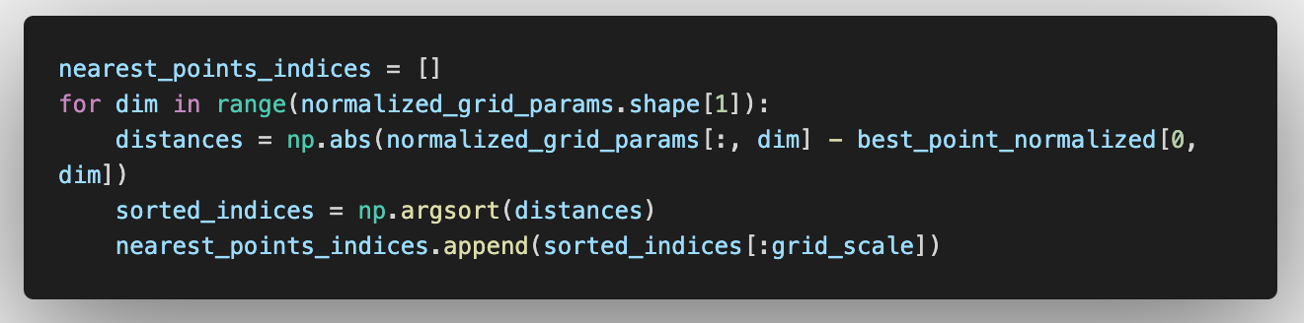
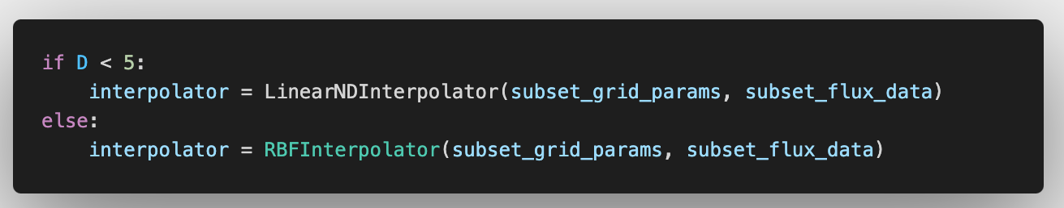
Interpolation
Model Wavelength
Reduced Grid
RBF vs. Linear
Sorted Wavelengths
5
Model Flux
Observed Wavelength
Grid Point Distance
from Best
Sort by Distance
Small Grids
BIG Grids

Slide 6
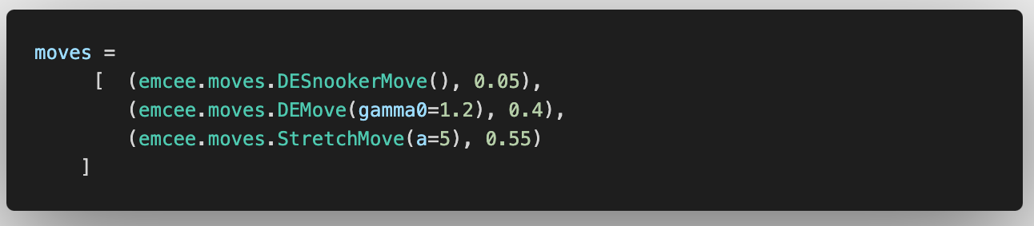
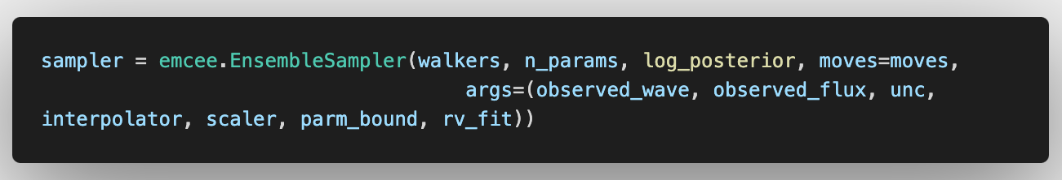
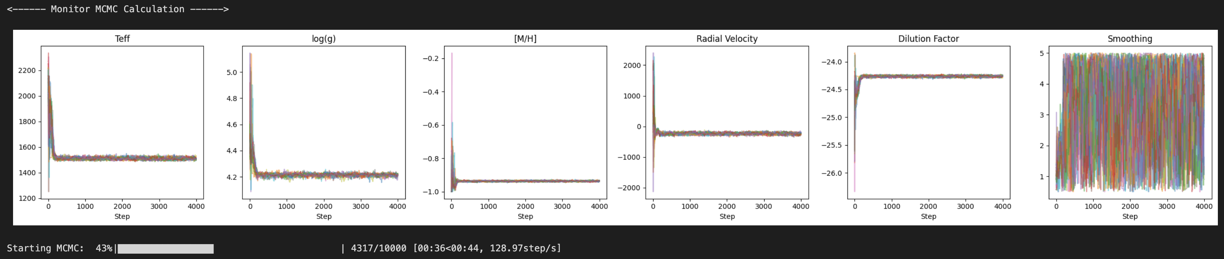
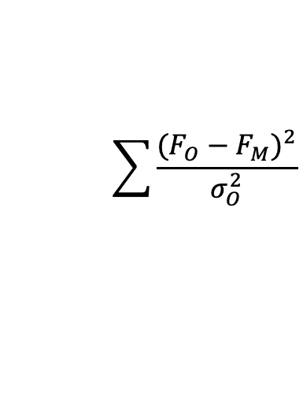
Markov-Chain Monte Carlo
χ² Statistic
𝜸 Stepping
Sampling
Monitoring
6
$$\sum{\frac{{(F_{O}−F_{M})}^{2}}{σ_{O}^{2}}}$$
Randomly Jumps
Walkers Talk More
Compresses Grid

Slide 7
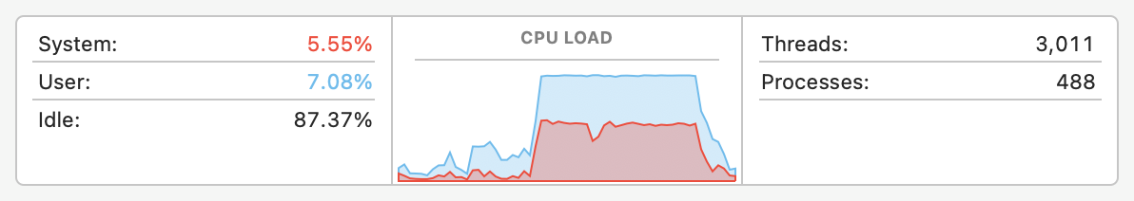
Computational Costs
7
CPU
~30%
5000 Steps
25 Walkers
8 Parameters
M2 MacBook
RAM
~1Gb
Time
~40s
Storage
<0.1Gb
5

Slide 8
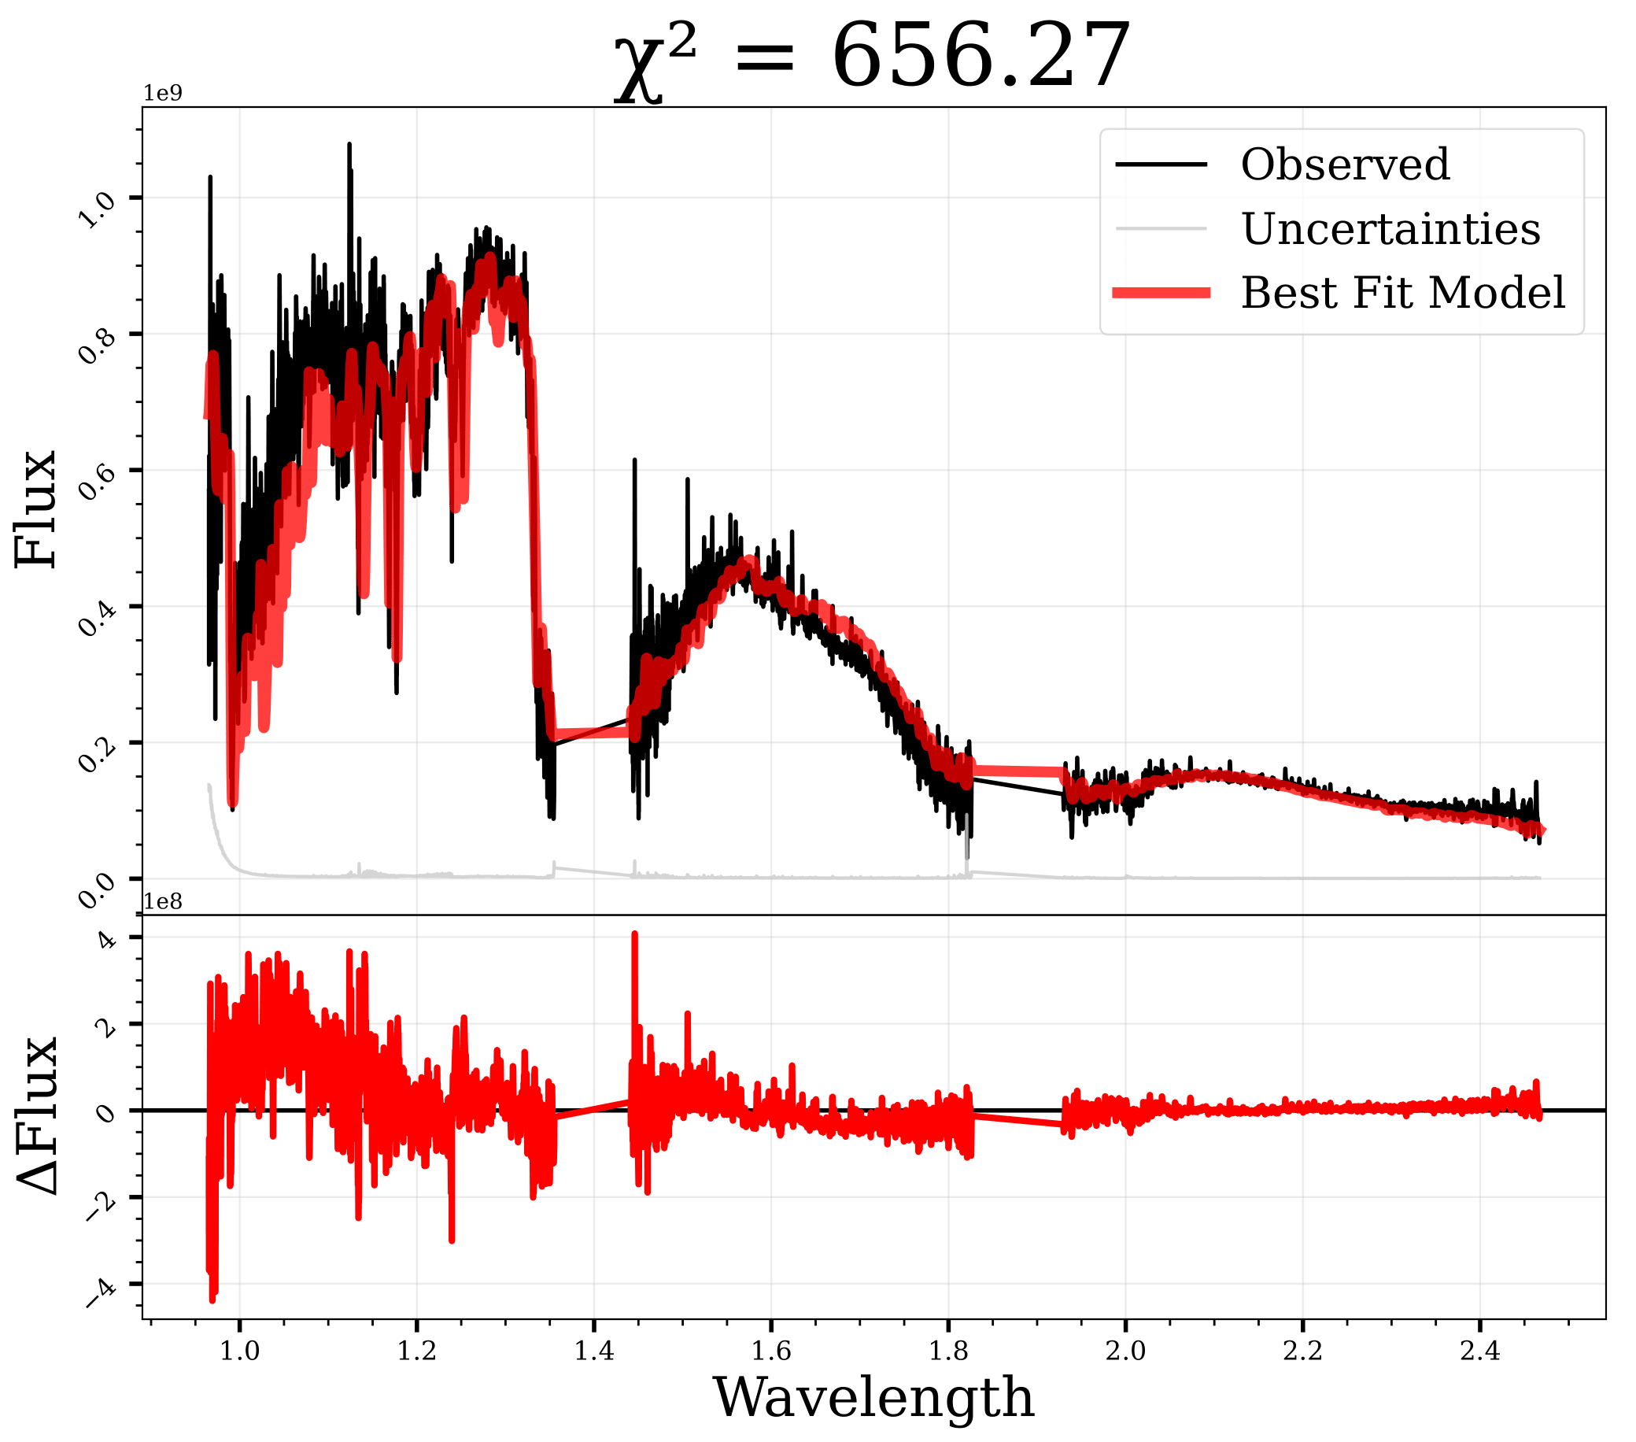
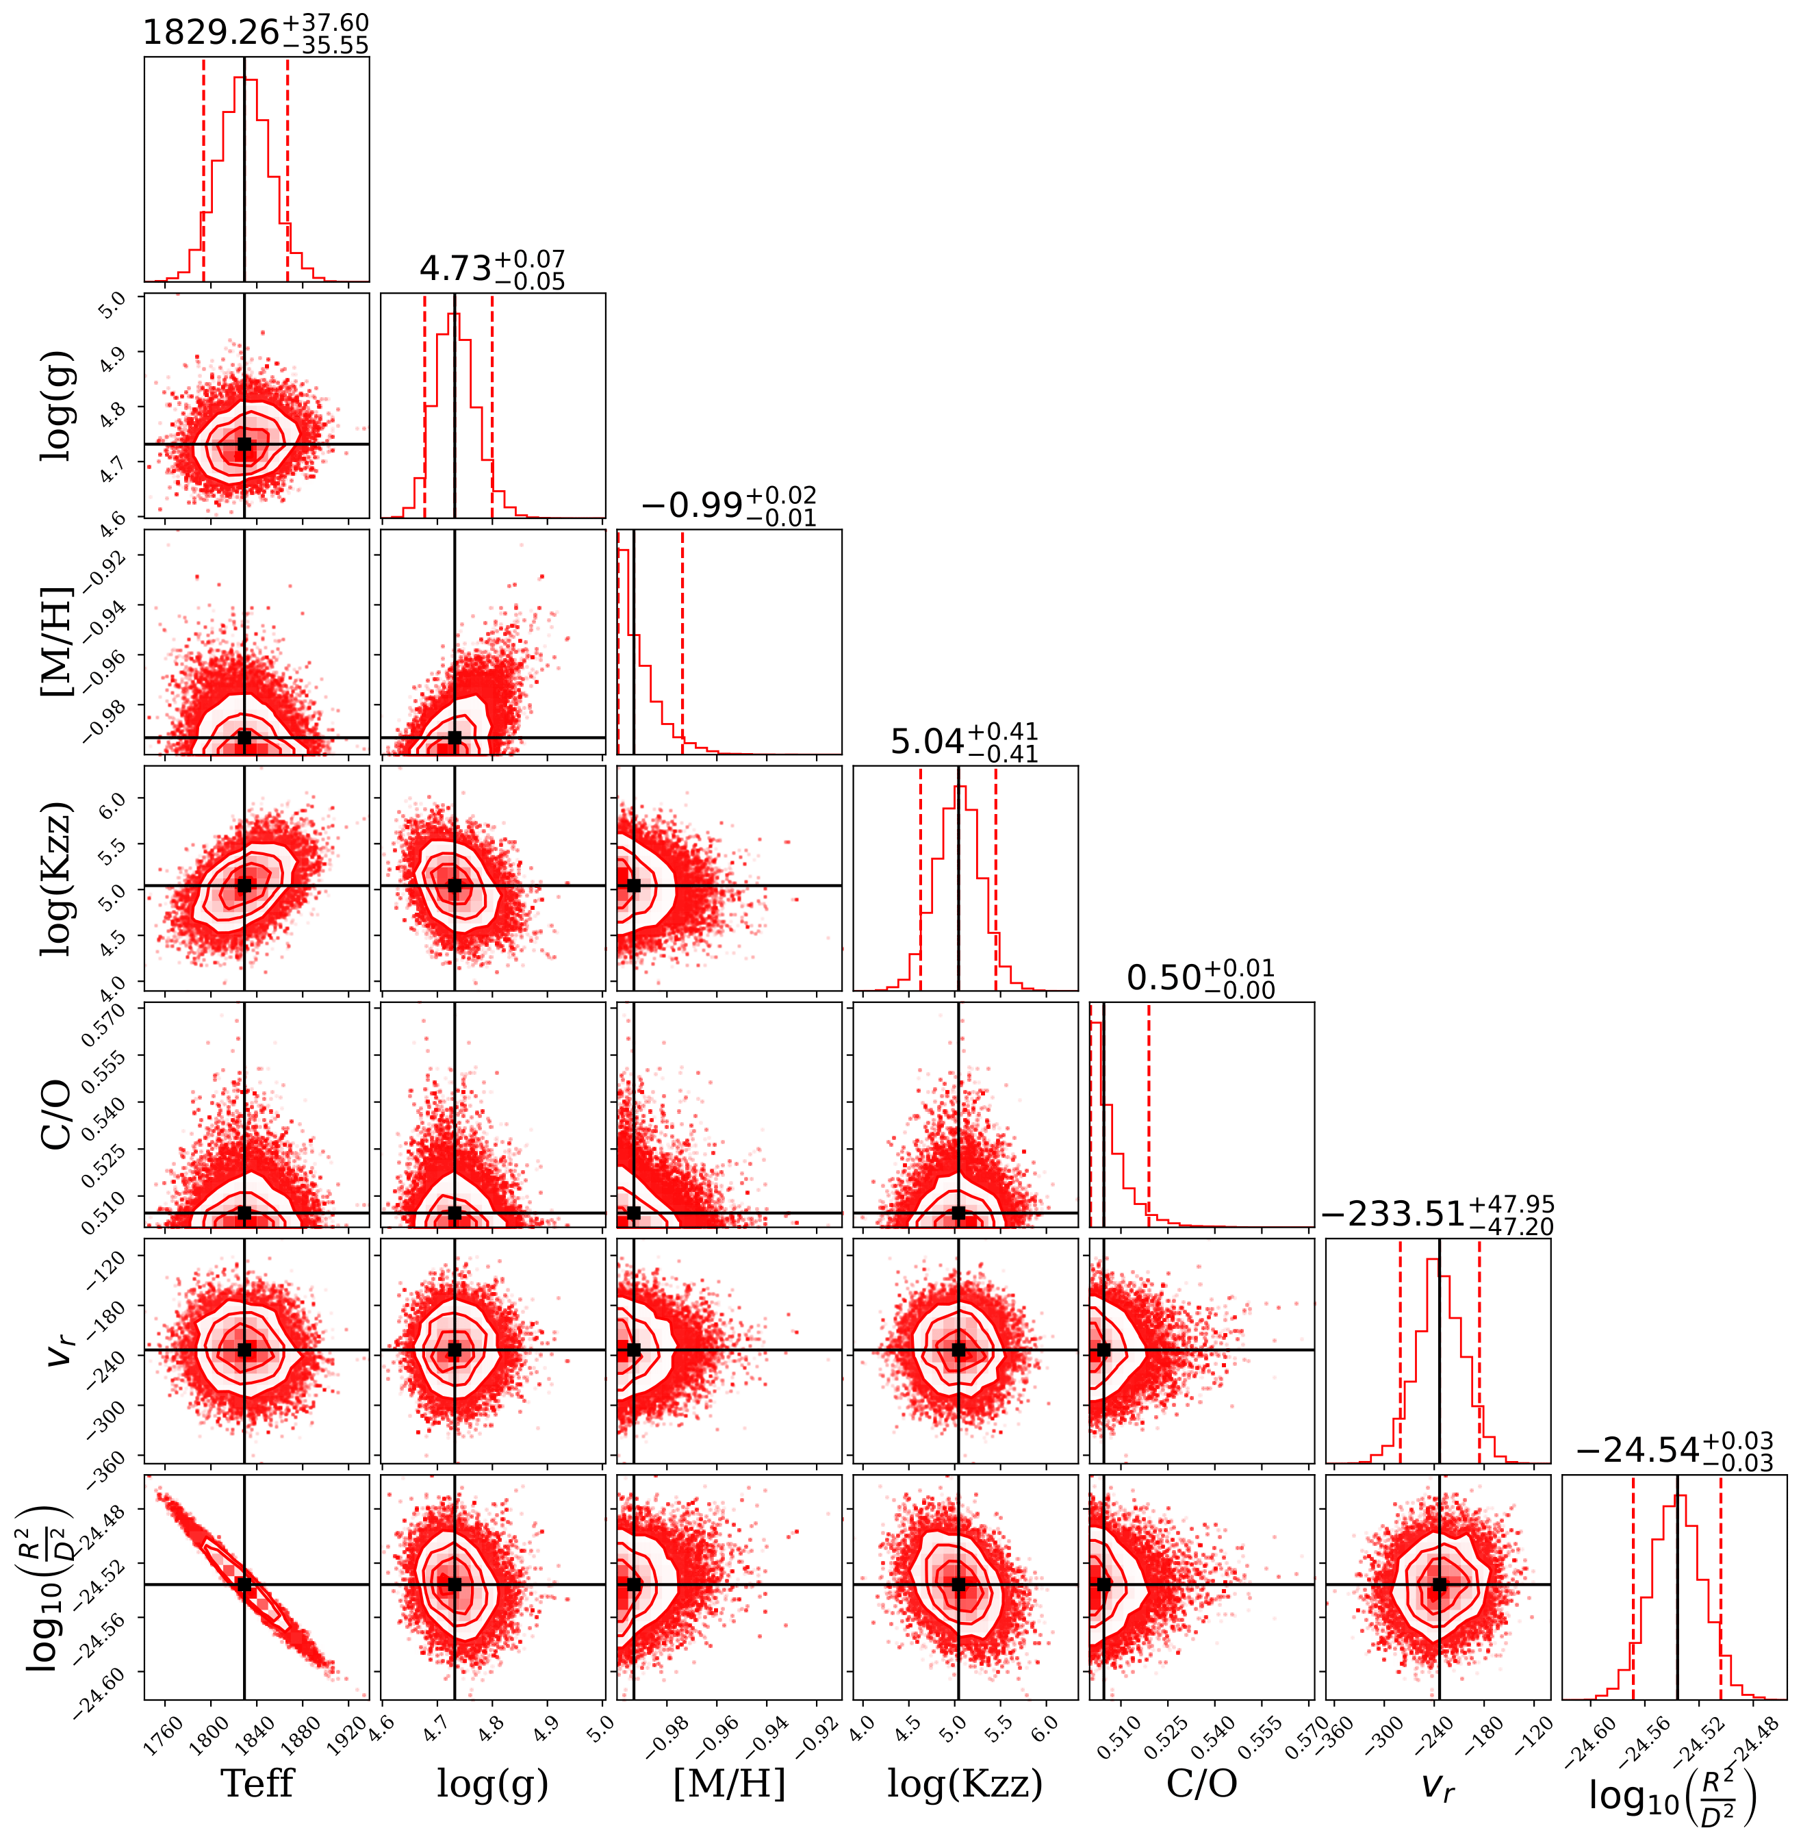
Example Fit
8
6
7

Slide 9
9
SCAN ME!
Conclusion
We present castl, an efficient MCMC algorithm for spectral parameter fitting using interpolated spectral grid points. Optimized for large data sets and complex data. Available for any astronomical objects from supernova to brown dwarfs.

